Slide 1
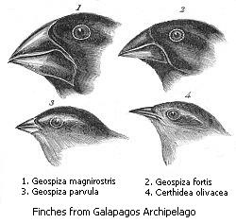
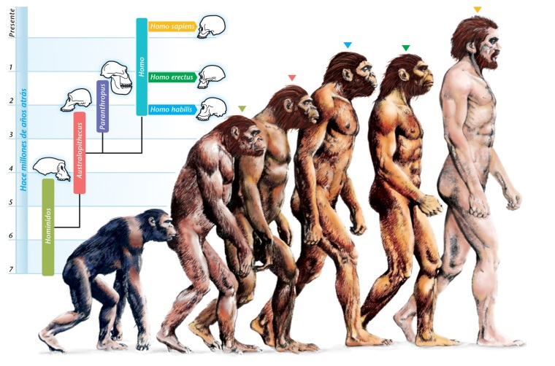
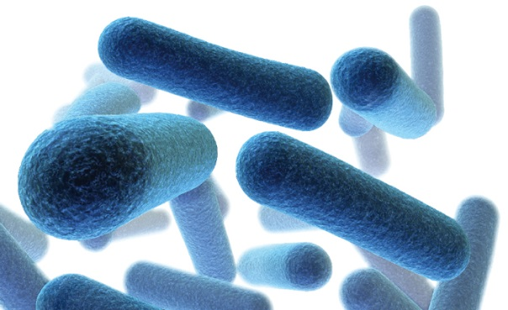
Evolution
“On the origin of species”
Charles Darwin 1859
Human evolution
Evolution of antibacterial resistance

Slide 2
Natural Selection
Let’s start with a homogeneous population of bacteria on a plate. All the bacteria are purple.

Slide 3
Natural Selection
Small DNA changes or mutations are happening all the time in these bacteria (and us). Let’s say one bacterium develops a mutation that lets it grow better than the other bacteria in the population. This new white mutant has a growth advantage over the old purple ones.

Slide 4
Natural Selection
Since the white mutant has an advantage, it begins to outgrow the original purple bacteria. This process is called natural selection.

Slide 5
Natural Selection
Eventually, the white mutant takes over the entire plate. The original strain is now extinct on the plate, and the bacteria has evolved.

Slide 6
Natural Selection
New mutant accounts for entire plate
Mutant appears and out competes original strain
Frequency of white colonies
Variable lag time until mutant appears
time
Over time, new mutations are constantly appearing in DNA. Occasionally one will come along that makes it better in this particular environment (represented by the blue line). Since it grows better, it becomes more and more common over time. Eventually, assuming the environment stays the same, the new mutant makes up most of the population.

Slide 7
Natural Selection
Frequency of white colonies
time
For natural selection in the wild, the growth advantage is usually very small and the selection process can take a long time (represented by the red line). There are exceptions though. For example, introduction of an antibiotic or a pesticide can quickly kill off competitors allowing any resistant organism to quickly take over (represented by the blue line). This experiment follows the blue line.

Slide 8
Optional: Selection coefficient
The selection coefficient s is a number that measures the relative fitness of two strains. It is an easy way to compare different mutations in terms of their growth advantage.
If white and purple grow at the same rate, then s = 0 and there is no selection.
If white grows faster than purple, then s > 0 and white will eventually overtake the plate. The bigger the advantage for white, the faster it will take over and so the larger the value for s.
If white grows slower than purple, then s < 0. Purple will arise and then disappear.
F

Slide 9
Natural Selection
Suppose a second mutant appears as white is overtaking purple.

Slide 10
Natural Selection
If the second mutant (red) is better than both white and purple, then it may outgrow them.

Slide 11
Natural Selection
Eventually, the red mutant sweeps the entire population. Now there are very few white or purple bacteria left.

Slide 12
Natural Selection
Second mutant outcompetes the first mutant
First mutant appears and out competes original strain
Frequency of white colonies
Variable lag time until first mutant appears
time
Here is a graphic representation of what has been discussed so far. First the white mutation (blue line) arises which has an advantage over the original purple one. Then a new red mutation (red line) appears that is better that white and purple. It eventually takes over the population.

Slide 13
Natural Selection
Imagine now the environment changes so red no longer has an advantage. Maybe red bacteria are resistant to penicillin and the white isn’t and the population is now in an environment without penicillin.

Slide 14
Natural Selection
Now what was an advantage (the red mutation) is a disadvantage in the new environment. The white bacteria now outgrow the red and eventually win out. Mutations are usually advantageous in certain environments.

Slide 15
Optional: Selection coeffiecient
In this lab, we will calculate the selection coefficient for the white mutant against the purple wild-type strain.
(ln (w(t2)/p(t2)) – ln(w(t1)/p(t1))
s = ΔT
t1 and t2 are timepoints.
w(t2) is white colonies/ml at t2.
w(t1) is white colonies/ml at t1.
p(t2) is purple colonies/ml at t2.
p(t1) is purple colonies/ml at t2.
ΔT is the number of purple cell divisions = log₂(p(t2)/p(t1))

Slide 16
Optional: Selection coeffiecient
(ln (w(t2)/p(t2)) – ln(w(t1)/p(t1))
s = ΔT
Suppose white grows twice as fast as purple.
At t1, lets say there are 1 white and 1 purple cells
After one cell division, we measure again and find 2 purple and 4 white cells.
p(t1) = 1 w(t1) = 1
p(t2) = 2 w(t2) = 4
w(t1)/p(t1) = 1 w(t2)/p(t2) = 2
ln (w(t2)/p(t2)) = .69 ln(w(t1)/p(t1) = 0
ΔT = 1
s = (.69 – 0)/1 = .69

